Slide 1


U2
New Zealanders
Group members:Zetong wu,Chen zhou,
Chenyi pan,Yutong cai

Slide 2

CONTENT
01/life in New Zealand
02/sports in New Zealand
03/etiquette in New Zealand
04/Conclusion

Slide 3



01
life in New
Zealand

Slide 4







Easy Living——casual,frank
Time Perception——no strong sense Eating habits——healthy
highest average life expectancy
in the world.

Slide 5

02
sports in New
Zealand

Slide 6




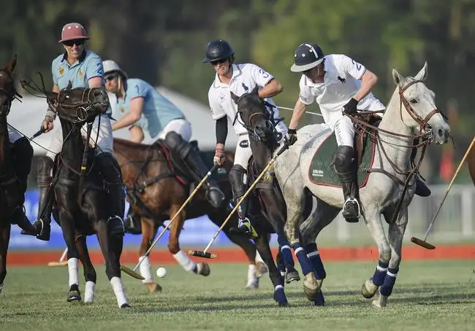
sail,outdoor,exciting sports,a large number of people joining。

Slide 7
03
etiquette in New
Zealand

Slide 8

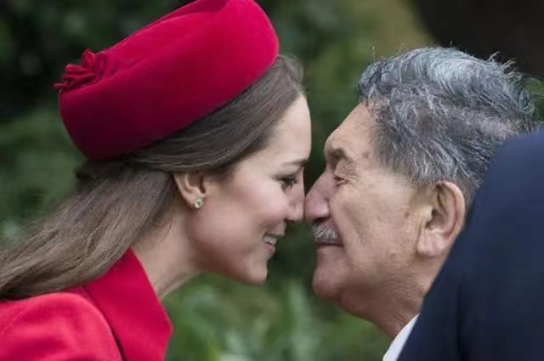
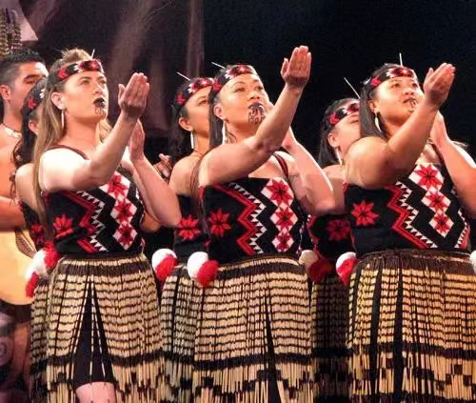
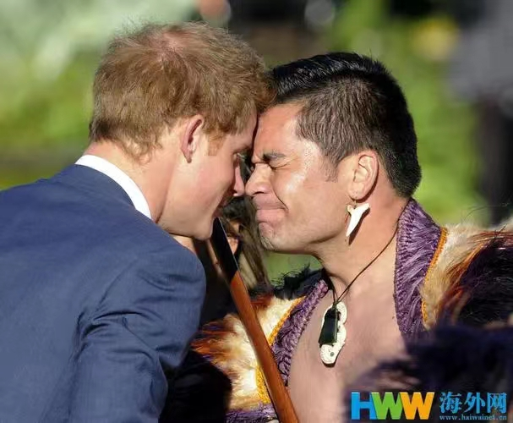
shake hands,
Hongji,
call each other‘s first names.
uncivilized behavior
(v sign,chewing gum,
etc.,disrespectful)

Slide 9
04
conclusion

Slide 10


THANKS FOR WATCHING

